Slide 1
Social IS
Facebook social network

Slide 2
Team members
1.علي قضب محمد علي
2. محمد احمد محمد علي
3. محمود محمد سيد
4. مصطفي حسني فرغلي

Slide 3
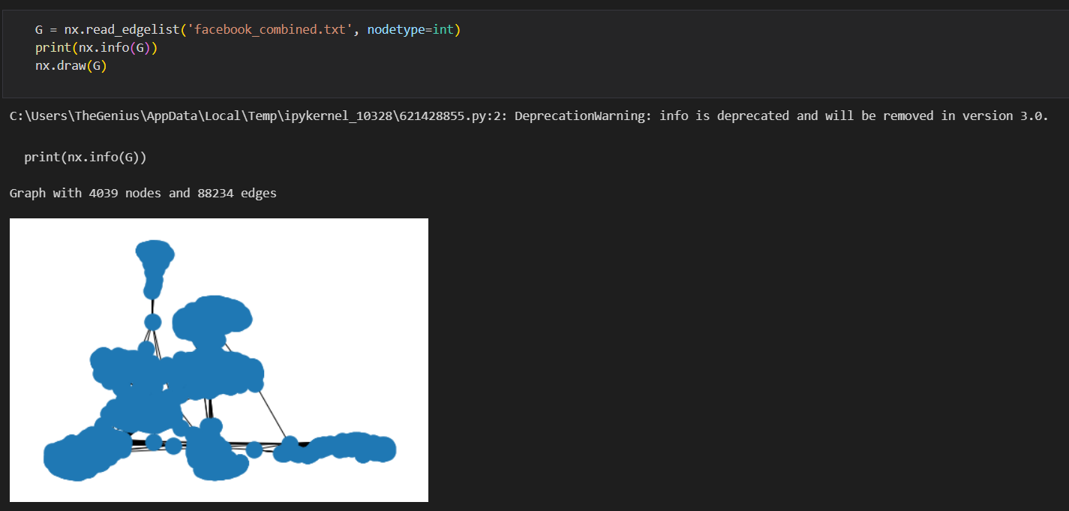
Reed & Draw dataset

Slide 4
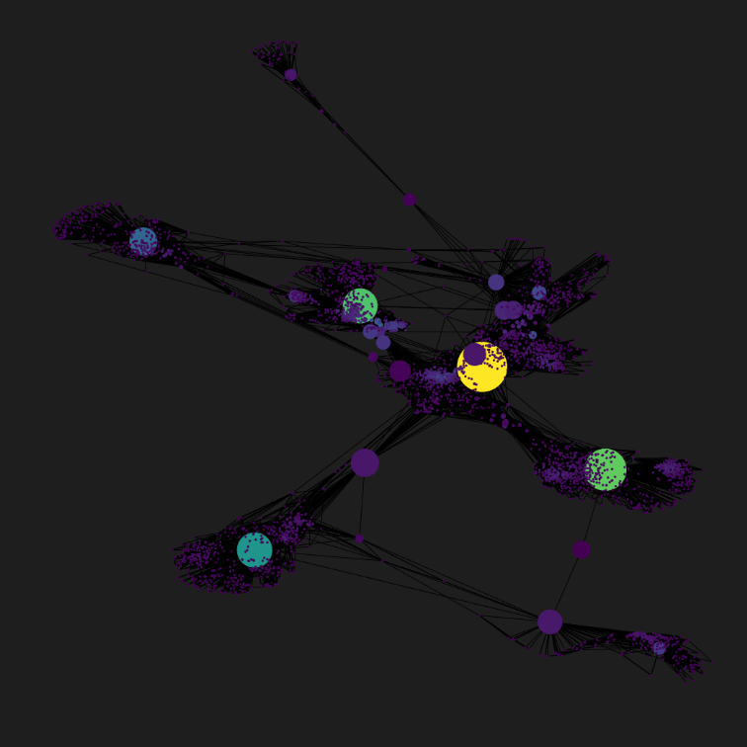
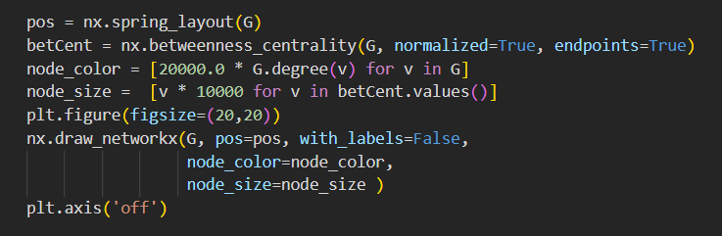
Nodes and Edges In dataset

Slide 5
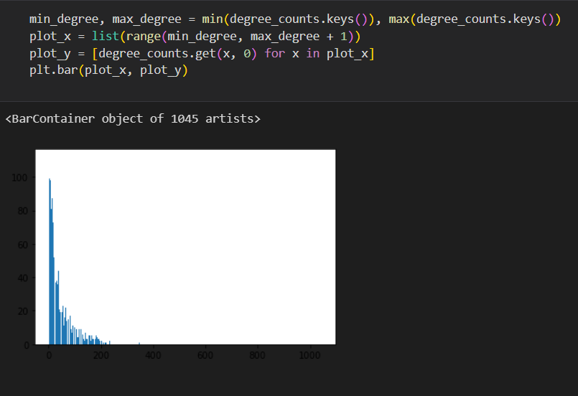
Degree distribution

Slide 6
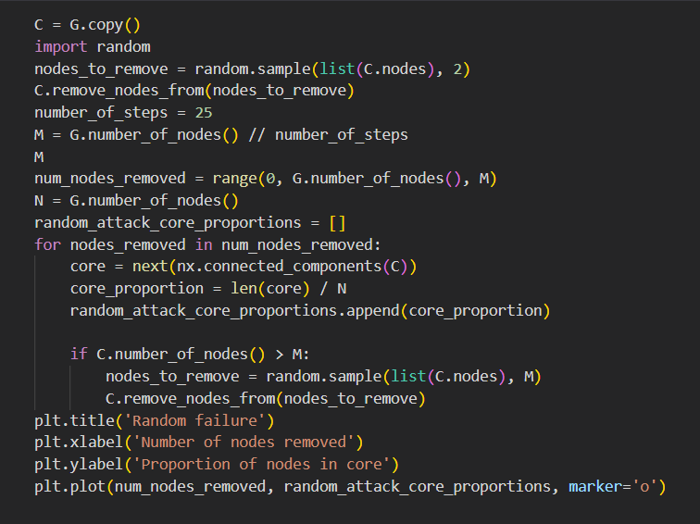
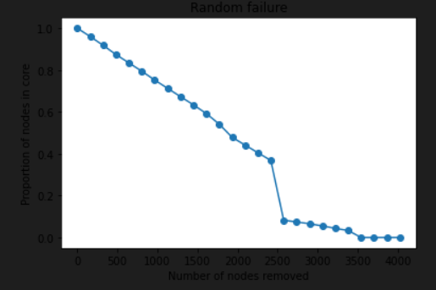
Random failure

Slide 7
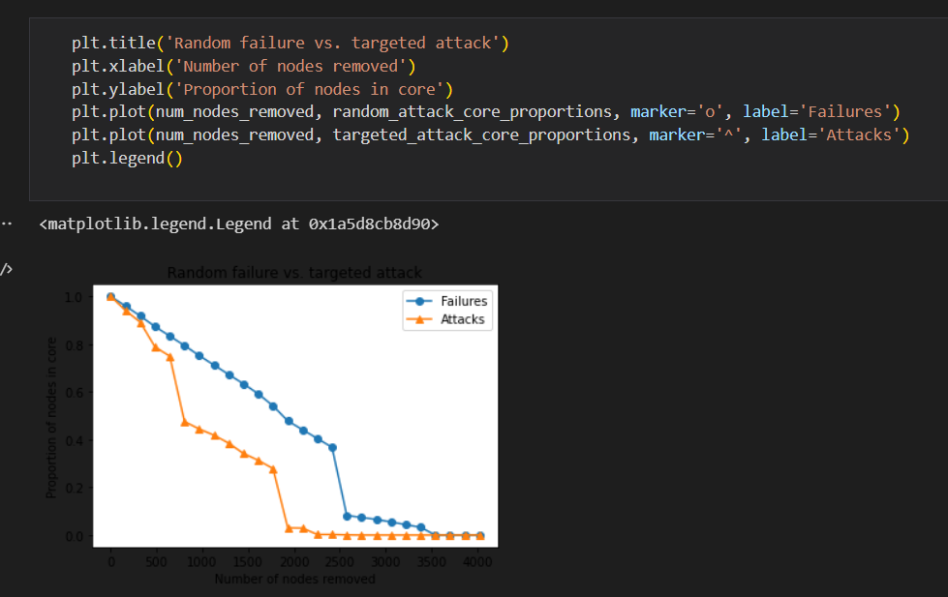
Failures vs attacks

Slide 8
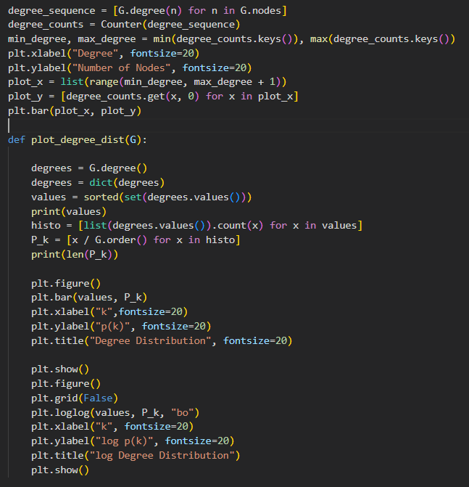
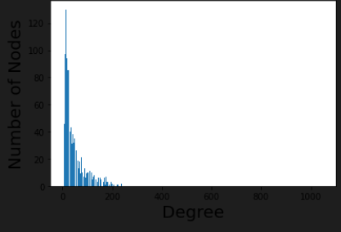
visualization

Slide 9
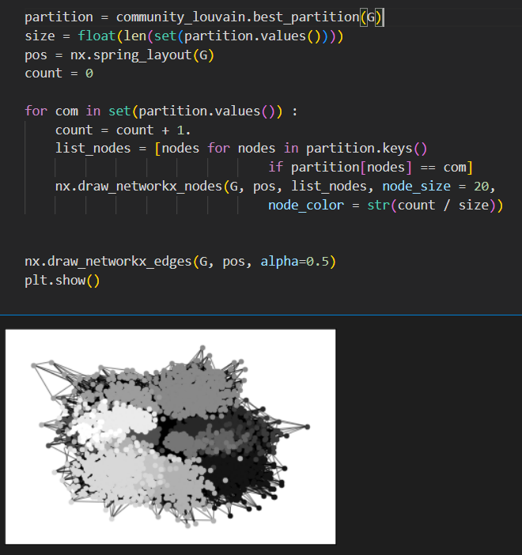
community

Slide 10
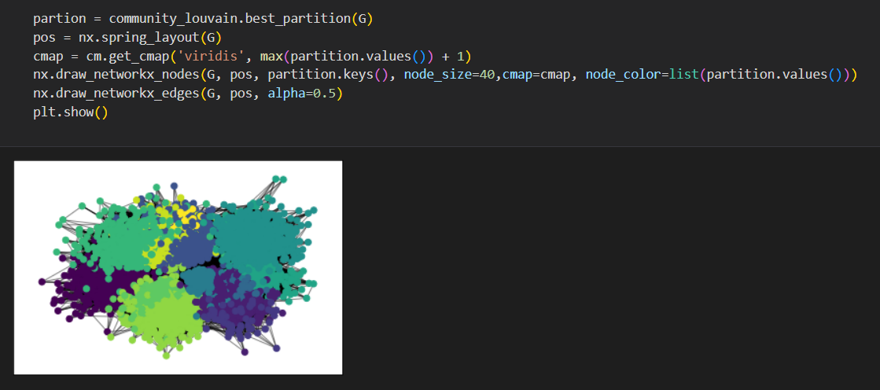
community

Slide 11
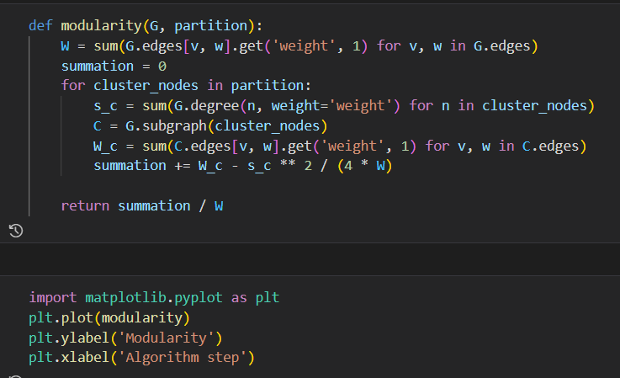
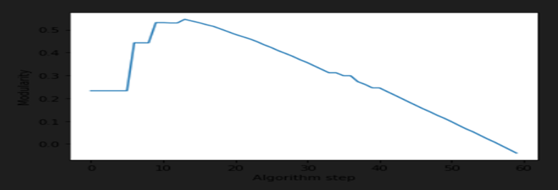
Modularity

